Slide 1
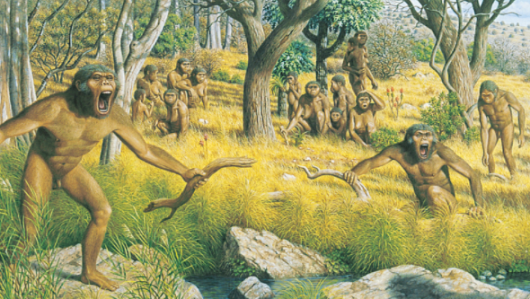
Human Ancestors: Paranthropus robustus
Habitat and Behaviour
Fossil Record
Anatomical Features

Slide 2
Date: | Human Biology Year 12 ATAR
Do Now Past exam question Hand in review worksheet Lesson Agenda 1: Do Now 2: Human Ancestors – Paranthropus 3: Lesson summary and windup Suggested Study Read through today’s notes and textbook section Complete review worksheet, then mark and correct using the answer key on Connect (compulsory). NEXT LESSON Homo habilis Homo erectus | Learning Aims Describe the main features of Paranthropus Describe the fossil record for Paranthropus Describe the following anatomical features of Paranthropus and compare these to modern day Great Apes and Humans: General skeletal structure Dentition Skull Femur and Pelvis
 | Key Vocabulary Paranthropus Sagittal Crest

Slide 3
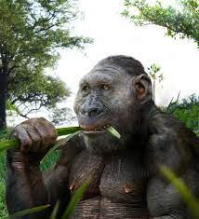
Paranthropus – Overview
Lived 1.8-1.2 million years ago in southern Africa
Likely several species including P. boisei but now an extinct line
Likely branched off evolutionary tree from Au. afarensis – Au. africanus and other Homo species another branch
Formerly known as “robust Australopithecines” due to skeletal differences with other “gracile Australopithecines”
Spent time in trees and on ground
Mostly vegetarian – roots and seeds, but also fruit
“Nutcracker Man” due to size of teeth and strong chewing muscles
Learning Aim: Describe the main features of Paranthropus

Slide 4
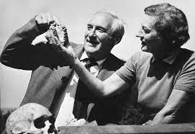
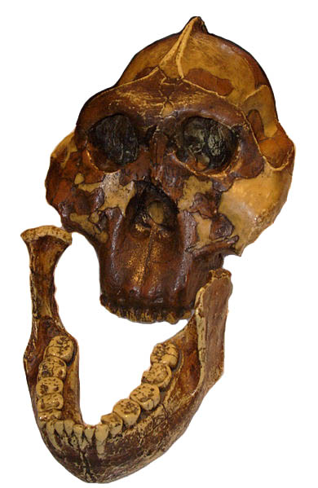
Paranthropus – Fossil Record
First fossil found in 1938
Robert Bloom
Jaw fragment and molar
Different skeletal structure to other Australo’s
Para = alongside; anthropus = man
More fossils found in 1955 in Olduvai Gorge, Tanzania
Mary Leakey (1959)
“Zinj” skull
P. boisei classified
Eventually three separate Para species identified
Learning Aim: Describe the fossil record for Paranthropus

Slide 5
Paranthropus – Anatomical Features - Dentition
Australopithecus |  | Human
Canines shorter than chimp, larger than human, non projecting Small diastema present Dental arcade becoming parabolic Teeth much larger than human – indicates plant based diet. |  | Canines small No diastema Parabolic dental arcade Teeth small – indicates omnivorous diet and less prognathism.
Learning Aim: Describe dentition of Paranthropus and compare to Australopithcines and humans

Slide 6
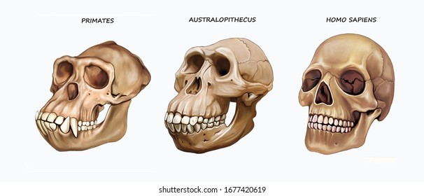
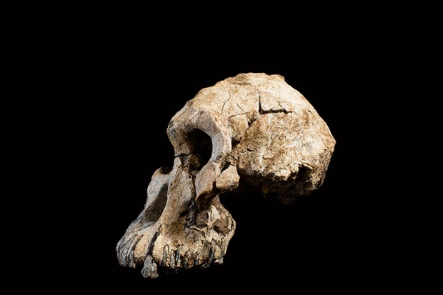
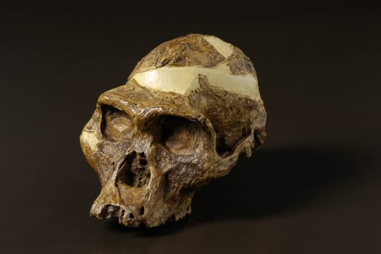
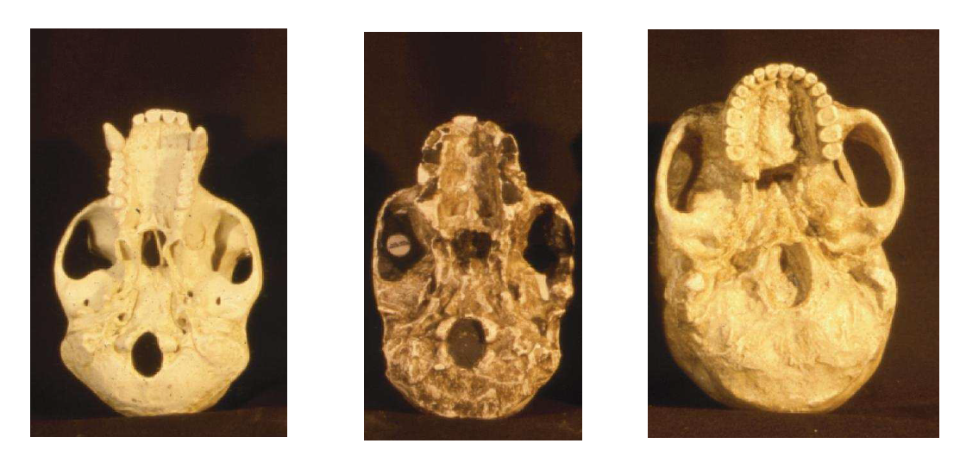
Australopithecines – Anatomical Features – Skull
Facial profile
Lower forehead, more projecting jaw than more modern hominins
Brain size 480cc, closer to modern gorilla than human
Relative brain size larger though: Australopithecus smaller than gorilla
Brain size and anatomy
Brain size 480cc, closer to modern gorilla than human
Relative brain size larger though: Australopithecus is smaller than gorilla
Endocasts show brain more similar to humans in structure
Foramen magnum more forward than in apes
Skull more rounded in back than in apes
Learning Aim: Describe the skull of Australopithecines and compare to modern apes and humans

Slide 7
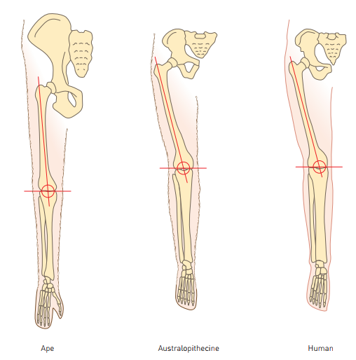
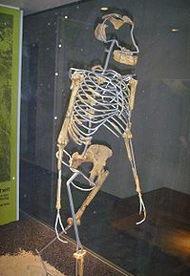
Australopithecines - Anatomical Features - Limb bones
Footprints show bipedal gait, although not quite the same as modern humans
Pelvis and carrying angle more similar to modern humans than to apes
Limb bones
Suggest bipedal locomotion
Pelvic and foot bones typically hominin
Non opposable, strongly built big toe
Thumb less mobile than modern humans, but more so than modern apes
Vertebral column – typically hominin curves
Foramen magnum – at base of skull.
Learning Aim: Describe the femur and pelvis of Australopithecines and compare to modern apes and humans

Slide 8
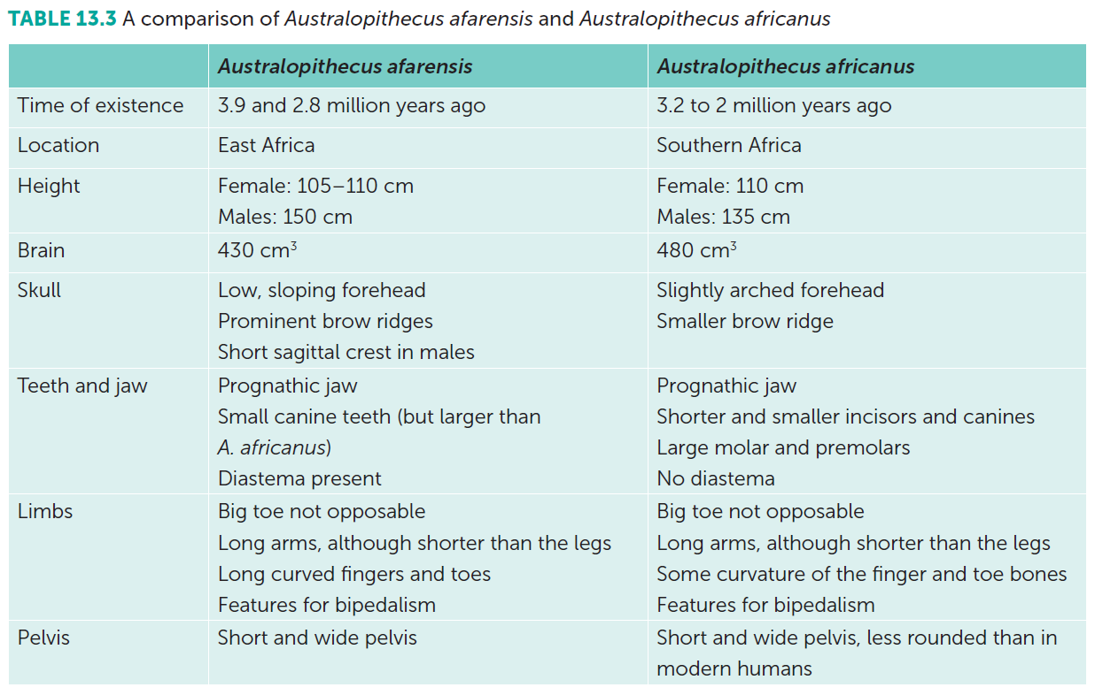
Evolutionary Progression in Australopithecines
More than one species of Australopithecine.
Australopithecus afarensis – earlier
Australopithecus africanus – later
Can see evolutionary transition between the two species:
Learning Aim: Discuss features that demonstrate evolutionary progession within the Australopithecus genus.

Slide 9
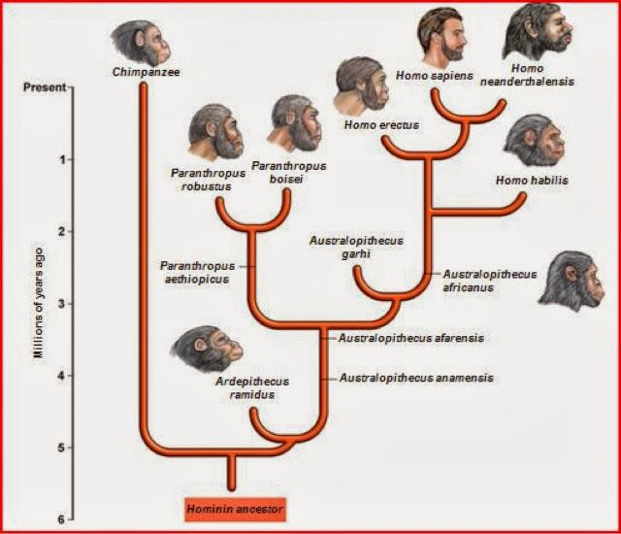
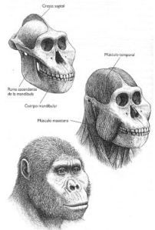
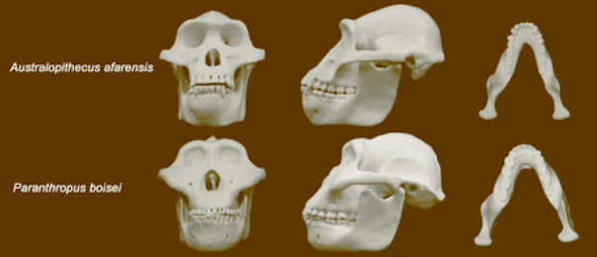
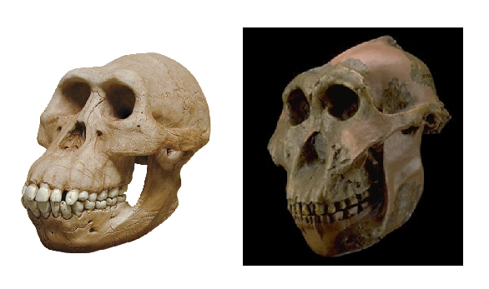
Paranthropus robustus
Closely related to Australopithecus
Paranthropus used to be classified as Australopithecus.
Different branch of the evolutionary tree.
Australopithecus | Paranthropus robustus
120-140cm tall | Up to 170cm tall
25-35 kg | Up to 70 kg
Proportional molars | Larger, broader molars
Smaller jaw muscles | Large jaw muscles and attachments, and sagittal crest
Australopithecus africanus Australopithecus afarensis Used to be classified as “gracile” Australopithecus | Paranthropus robustus used to be classified as “robust” Australopithecus
Learning Aim: Describe differences between Australopithecus and the closely related Paranthropus.

Slide 10
